Slide 1

Neural Style Transfer
What is neural style transfer?
deeplearning.ai

Slide 2
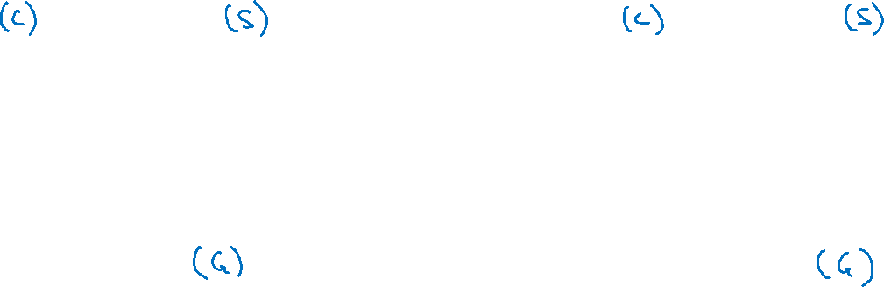
Neural style transfer
Content
Style
Content
Style
Generated image
Generated image
[Images generated by Justin Johnson]

Slide 3
Neural Style Transfer
What are deep
ConvNets learning?
deeplearning.ai

Slide 4
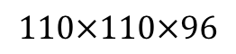
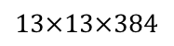
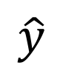
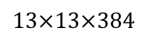
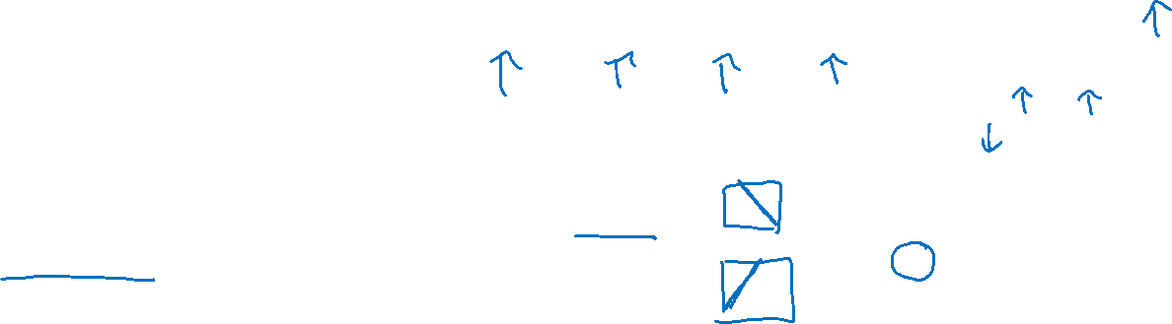

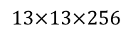

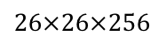
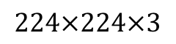
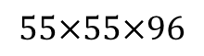
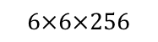
Visualizing what a deep network is learning
Note: 3 by 3 max pool with stride 2:
$$\hat{y}$$
$$⋮$$
$$⋮$$
$$26×26×256$$
$$13×13×256$$
$$13×13×384$$
$$13×13×384$$
$$6×6×256$$
$$55×55×96$$
FC
4096
FC
4096
$$224×224×3$$
$$110×110×96$$
Pick a unit in layer 1. Find the nine image patches that maximize the unit’s activation.
Repeat for other units.
[Zeiler and Fergus., 2013, Visualizing and understanding convolutional networks]

Slide 5
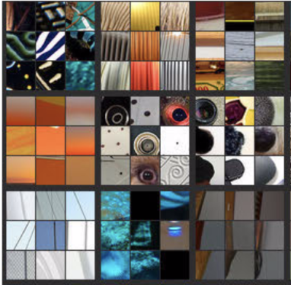
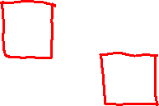
Visualizing deep layers
Layer 1
Layer 2
Layer 3
Layer 4
Layer 5

Slide 6
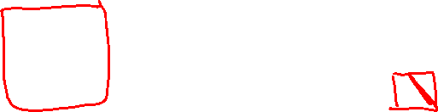
Visualizing deep layers: Layer 1
Layer 1
Layer 2
Layer 3
Layer 4
Layer 5

Slide 7
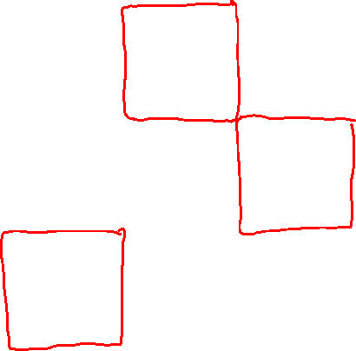
Visualizing deep layers: Layer 2
Layer 1
Layer 2
Layer 3
Layer 4
Layer 5

Slide 8

Visualizing deep layers: Layer 3
Layer 1
Layer 2
Layer 3
Layer 4
Layer 5

Slide 9
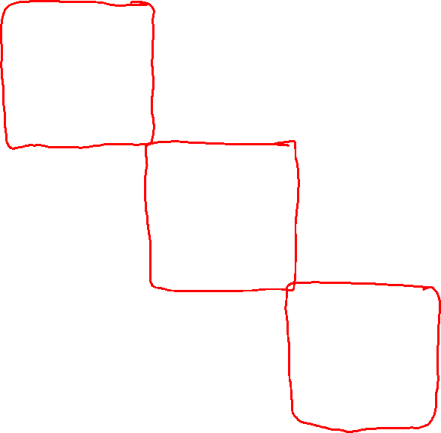
Visualizing deep layers: Layer 3
Layer 1
Layer 2
Layer 3
Layer 4
Layer 5

Slide 10
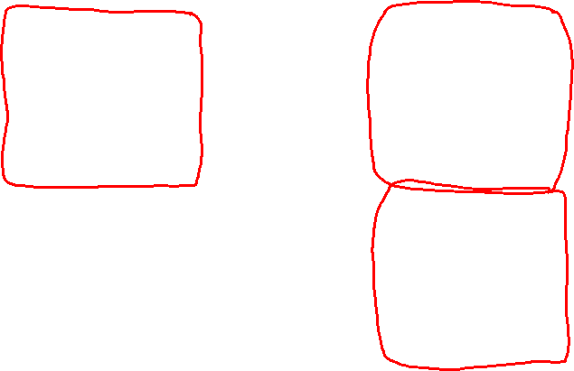
Visualizing deep layers: Layer 4
Layer 1
Layer 2
Layer 3
Layer 4
Layer 5

Slide 11
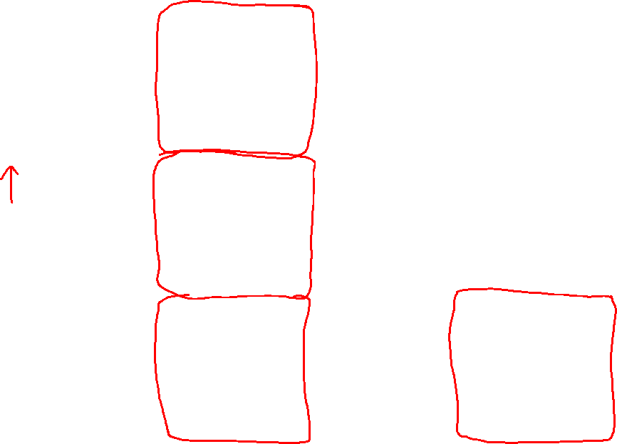
Visualizing deep layers: Layer 5
Layer 1
Layer 2
Layer 3
Layer 4
Layer 5

Slide 12
Neural Style Transfer
Cost function
deeplearning.ai

Slide 13
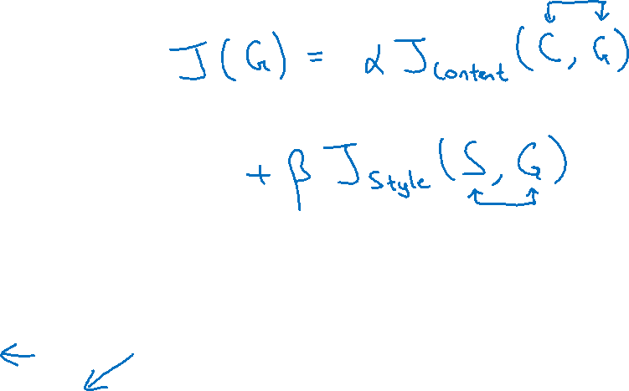
Neural style transfer cost function
Content C
Style S
Generated image G
[Gatys et al., 2015. A neural algorithm of artistic style. Images on slide generated by Justin Johnson]

Slide 14

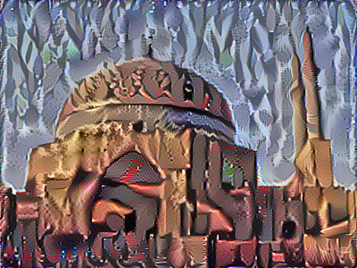
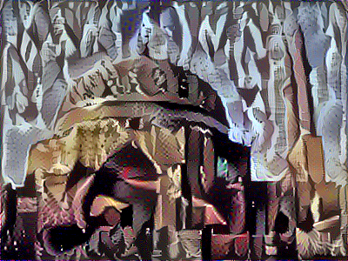
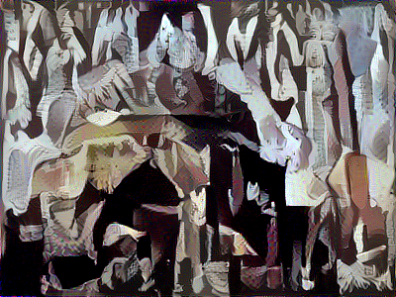

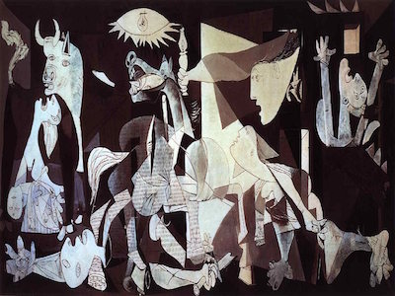
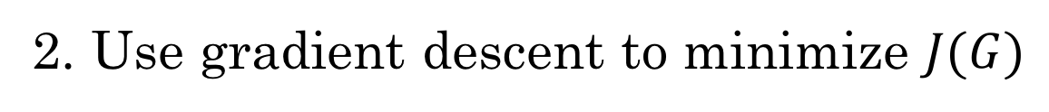
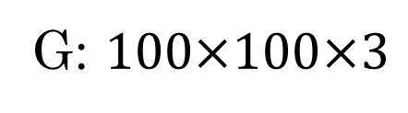
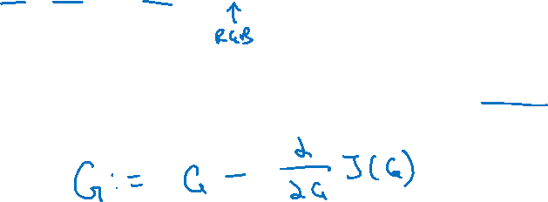
Find the generated image G
1. Initiate G randomly
G: $100×100×3$
2. Use gradient descent to minimize $J(G)$
[Gatys et al., 2015. A neural algorithm of artistic style]

Slide 15
Neural Style Transfer
Content cost function内容代价函数
deeplearning.ai

Slide 16
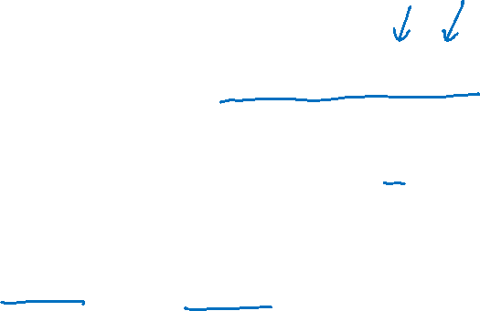
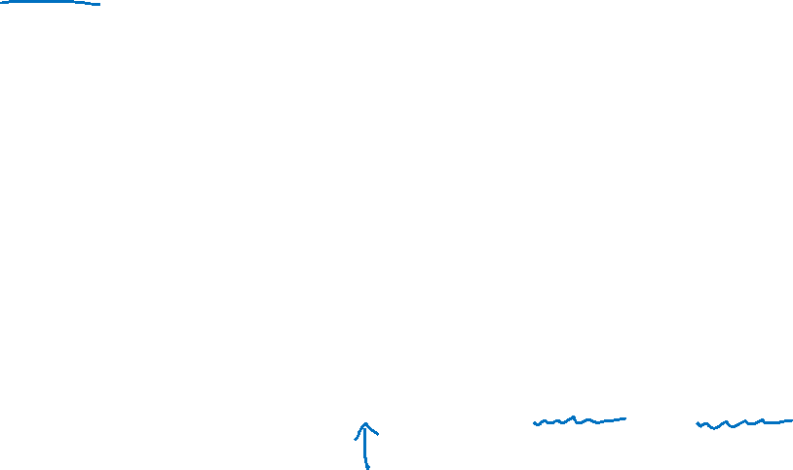
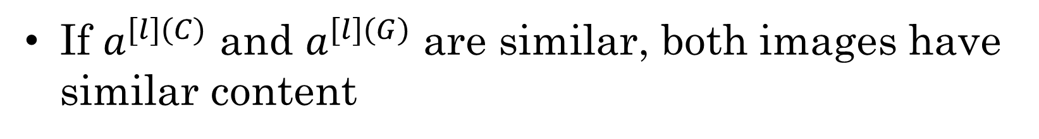
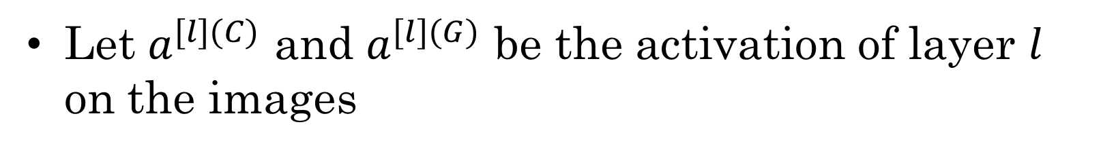
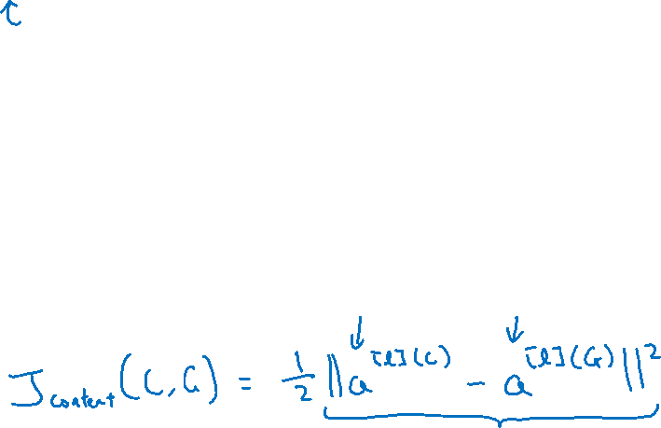
Content cost function
$$J\left(G\right)=α J_{content}\left(C,G\right)+β J_{style }(S,G)$$
Say you use hidden layer $l$ to compute content cost.
Use pre-trained ConvNet. (E.g., VGG network)
Let $a^{[l](C)}$ and $a^{[l](G)}$ be the activation of layer $l$ on the images
If $a^{[l](C)}$ and $a^{[l](G)}$ are similar, both images have similar content
[Gatys et al., 2015. A neural algorithm of artistic style]

Slide 17
Neural Style Transfer
Style cost function
风格代价函数
deeplearning.ai

Slide 18
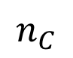
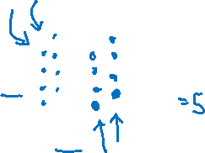
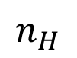
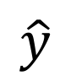
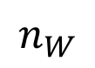

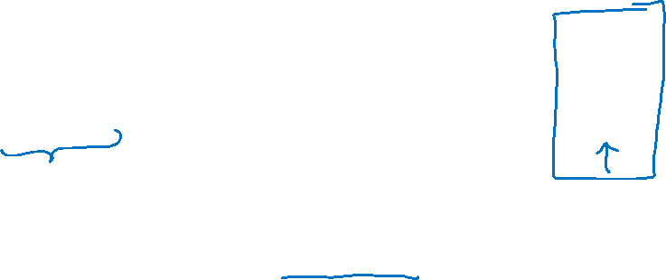
Meaning of the “style” of an image
$$\hat{y}$$
$$⋮$$
Say you are using layer $l$’s activation to measure “style.”
Define style as correlation between activations across channels.
How correlated are the activations across different channels?
$$n_{H}$$
$$n_{C}$$
$$n_{W}$$
[Gatys et al., 2015. A neural algorithm of artistic style]

Slide 19
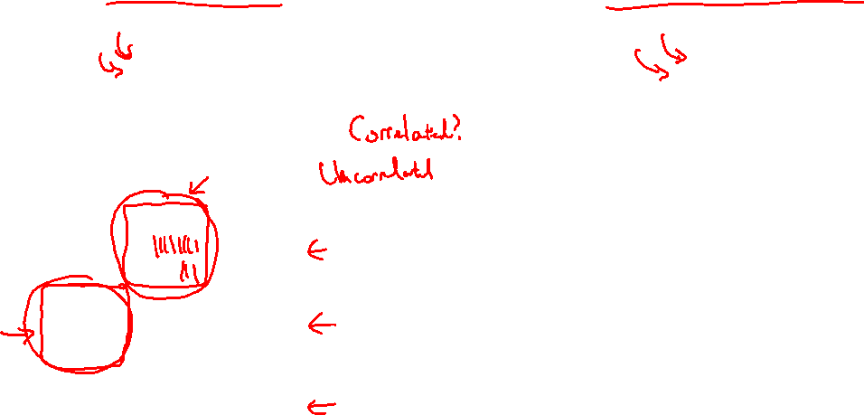
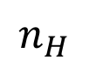
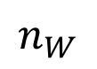
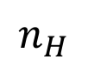
Intuition about style of an image
Style image
Generated Image
$$n_{H}$$
$$n_{H}$$
$$n_{C}$$
$$n_{C}$$
$$n_{W}$$
$$n_{W}$$
[Gatys et al., 2015. A neural algorithm of artistic style]

Slide 20
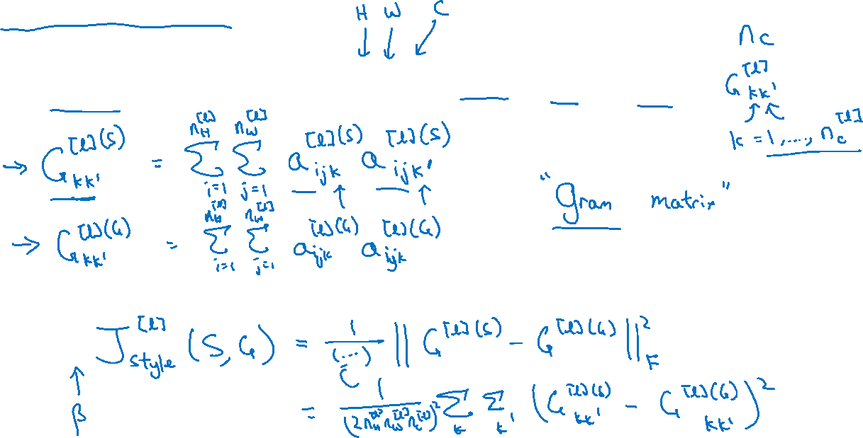
Style matrix
Let $a_{i,j,k}^{[l]}=$ activation at $\left(i,j,k\right). G^{[l]}$ is $n_{c}^{[l]}×n_{c}^{[l]}$
[Gatys et al., 2015. A neural algorithm of artistic style]

Slide 21
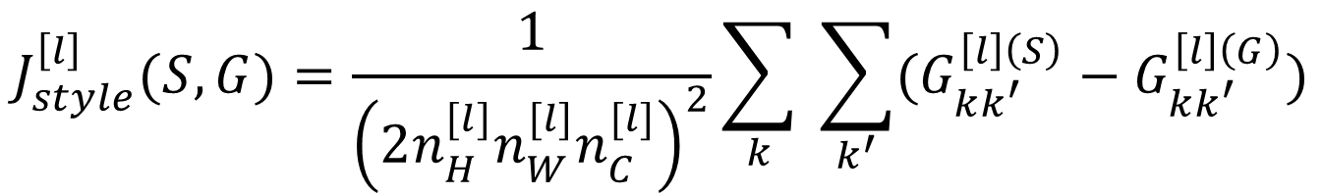
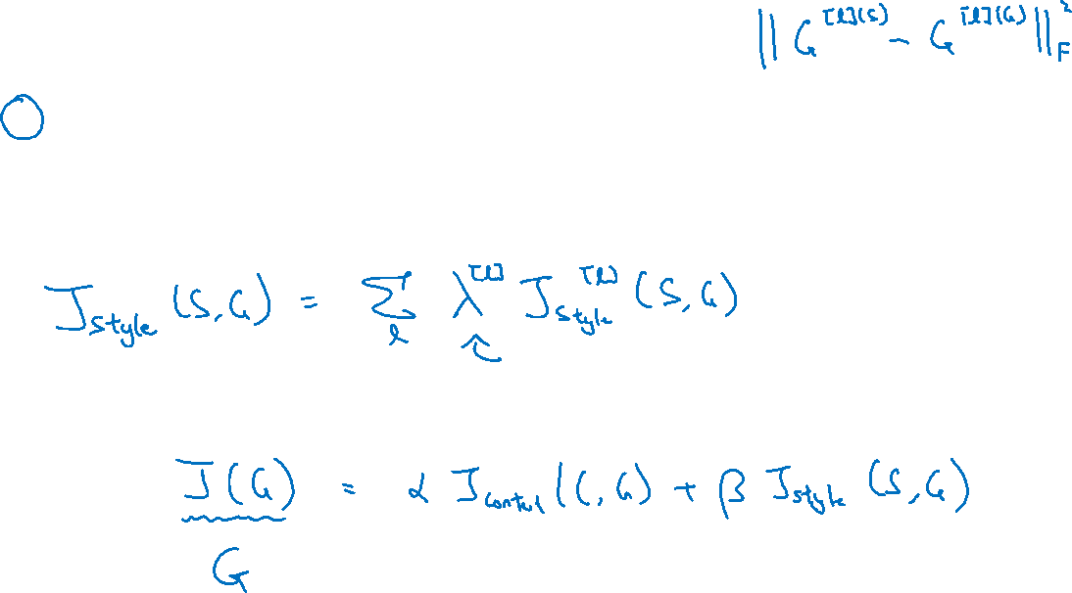
Style cost function
$$J_{style}^{\left[l\right]}(S,G)=\frac{1}{{\left(2n_{H}^{[l]}n_{W}^{[l]}n_{C}^{[l]}\right)}^{2}}\sum_{k}{ \sum_{k^{′}}{(G_{kk^{′}}^{\left[l\right]\left(S\right)}−G_{kk^{′}}^{\left[l\right]\left(G\right)})}}$$
[Gatys et al., 2015. A neural algorithm of artistic style]

Slide 22
Convolutional Networks in 1D or 3D
1D and 3D generalizations of models
deeplearning.ai

Slide 23
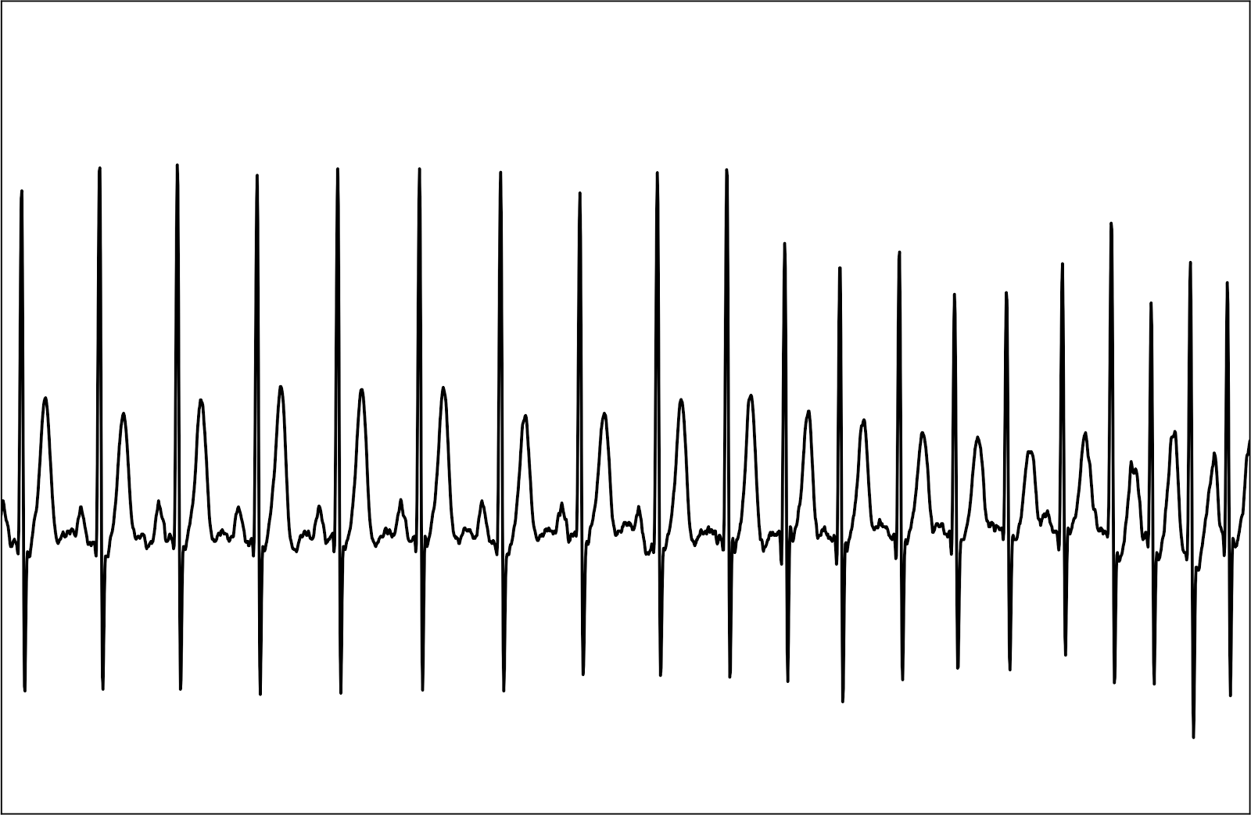


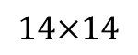
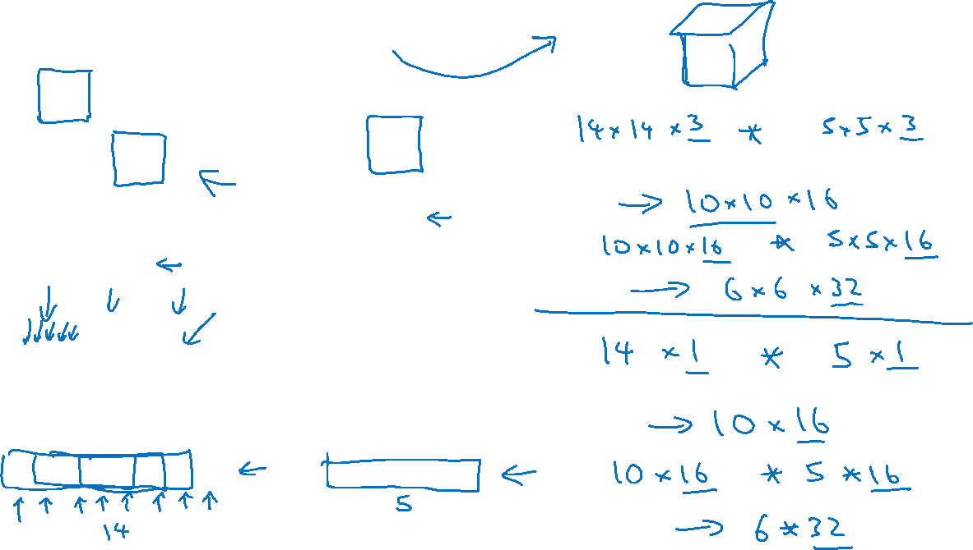
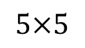
Convolutions in 2D and 1D
$$∗$$
2D filter
$$5×5$$
2D input image
$$14×14$$
$$∗$$
1 | 20 | 15 | 3 | 18 | 12 | 4 | 17
1 | 3 | 10 | 3 | 1

Slide 24
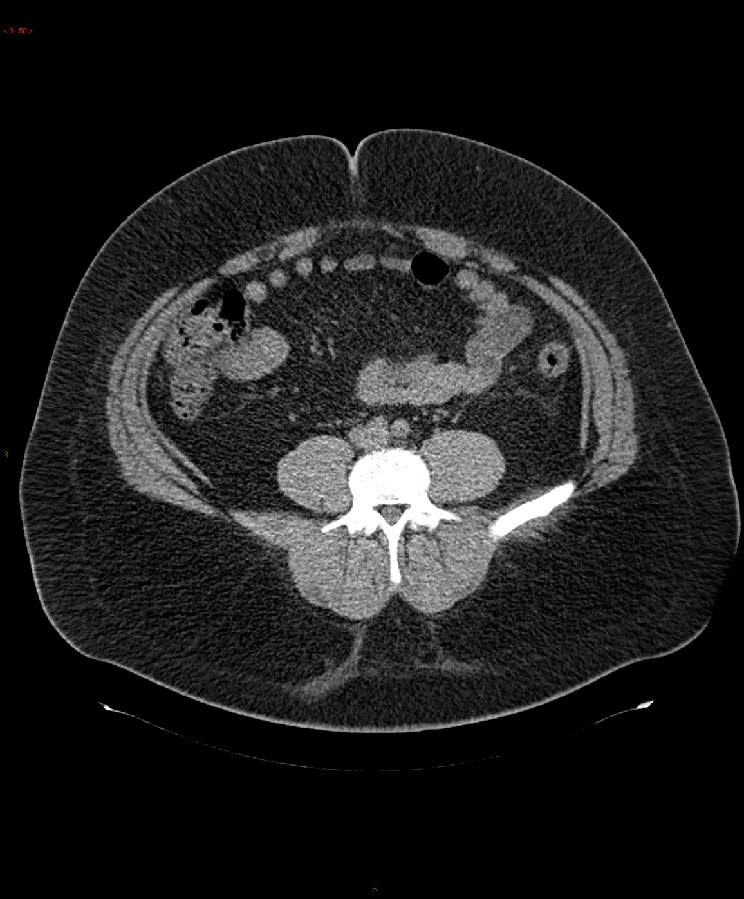
3D data
Andrew Ng

Slide 25
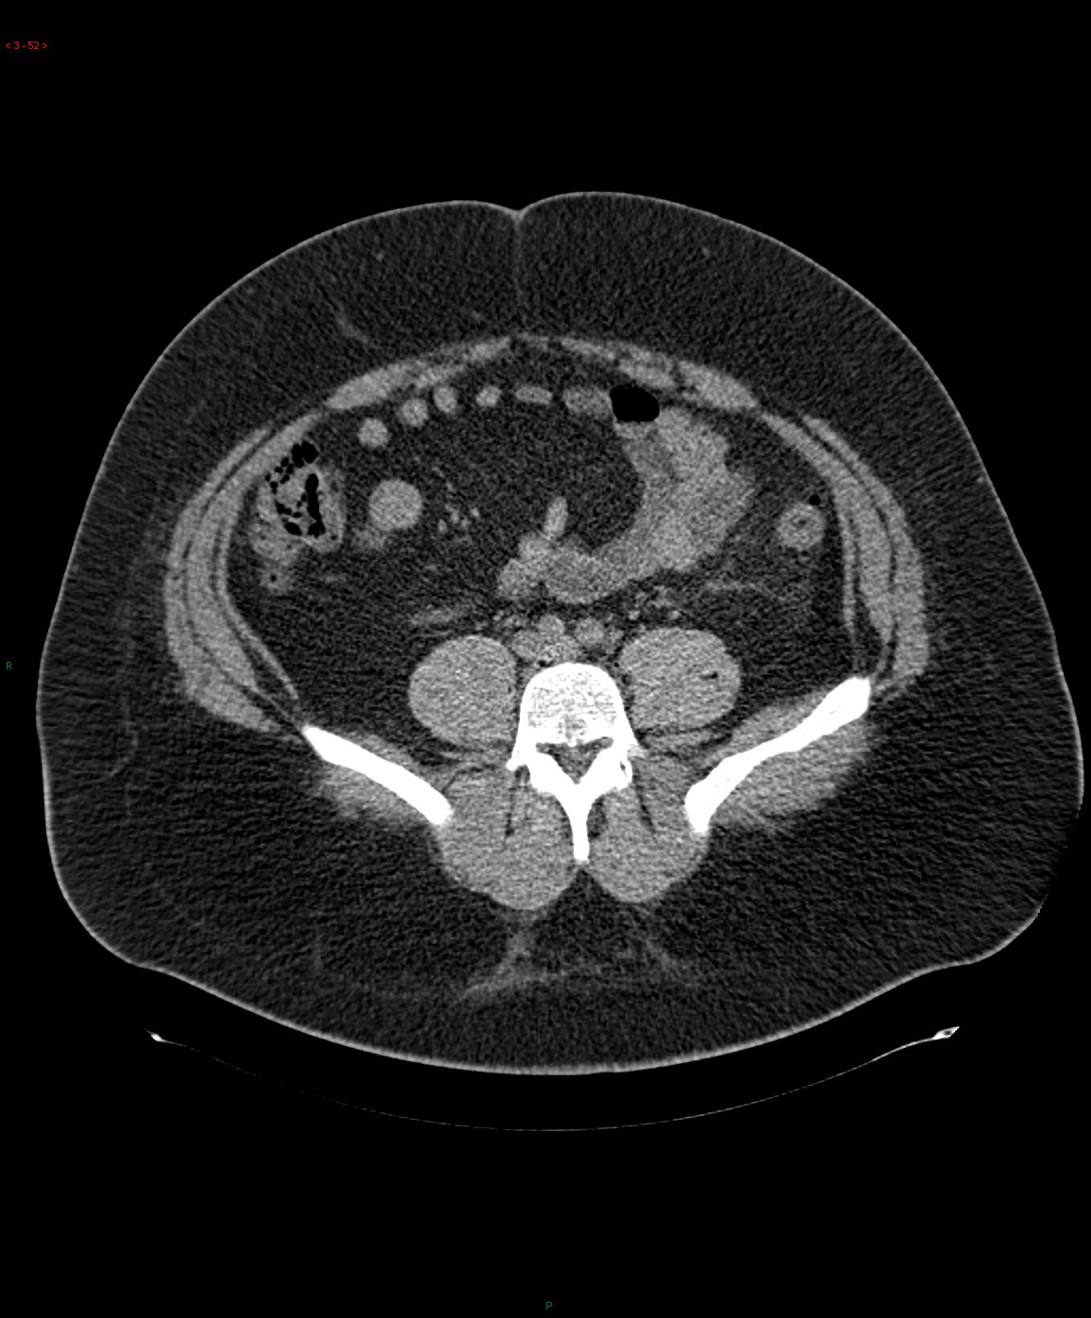
3D data
Andrew Ng

Slide 26

3D data
Andrew Ng

Slide 27

3D data
Andrew Ng

Slide 28

3D data
Andrew Ng

Slide 29

3D data
Andrew Ng

Slide 30

3D data
Andrew Ng

Slide 31

3D data
Andrew Ng

Slide 32

3D data
Andrew Ng

Slide 33

3D data
Andrew Ng

Slide 34


3D data
Andrew Ng

Slide 35


3D convolution
$$∗$$
3D filter
3D volume

